Slide 1

Expansion in NYC
Burhanuddin.Saboowala

Slide 2
Agenda
Objective
Background
Key findings
Recommendations
Appendix:
Data sources
Data methodology

Slide 3
Objective
Improve our shared understanding of boroughs around NYC.
Improve our understanding about market conditions.
To identify underserved areas by the client’s competitors for potential expansion of operations.

Slide 4
Background
Midtown Manhattan and Lower Manhattan are the primary commercial centers of the city, with Downtown Brooklyn also experiencing significant growth.
Brooklyn and Queens have the largest residential populations, while the Bronx is mostly residential as well.
Tourist attractions in New York City are frequently found in or near the commercial areas.

Slide 5
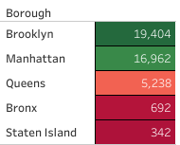
Boroughs having Highest Home Rental accommodations
Brooklyn has the highest number of Residential Accommodations and Manhattan being the second.

Slide 6
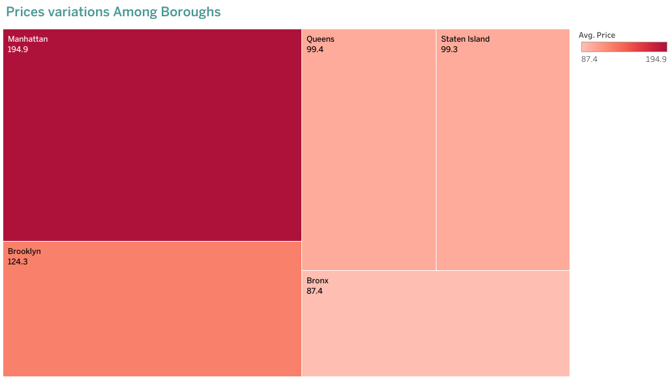
Price Variations among Boroughs
Manhattan being the center for most commercial residents has the highest price has compared to Bronx which has only residential housing.
Brooklyn can be considered as it most convenient place for expansion has it is close to commercial neighborhoods and has cheaper is compared to Manhattan.

Slide 7
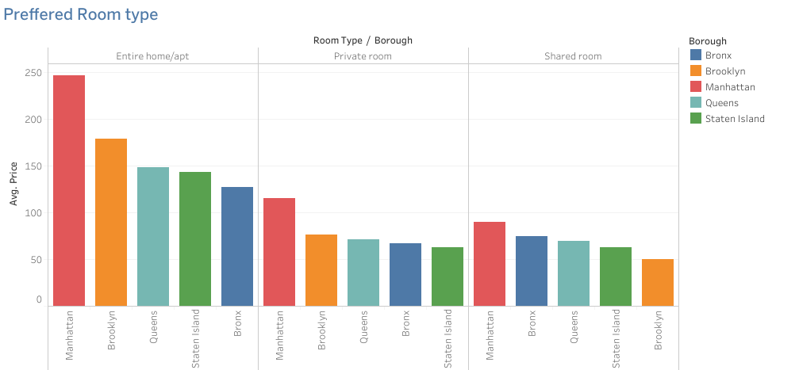
Most Preferred Room Type
We can clearly see that Entire home/apartment in Manhattan, Brooklyn are the most popular room type.

Slide 8
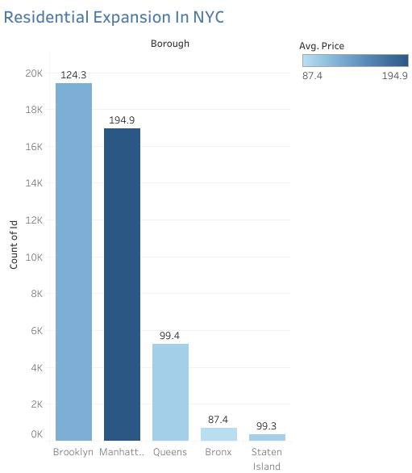
Boroughs should the company explore for expansion into the residential accommodation
Brooklyn and Manhattan have the highest number of hosting's as compared to Bronx and Queens.
Bronx has mostly residential houses and which is much cheaper than Manhattan and Brooklyn.
Brooklyn can be considered as it most convenient place for expansion has it is close to commercial neighborhoods and has cheaper is compared to Manhattan.

Slide 9
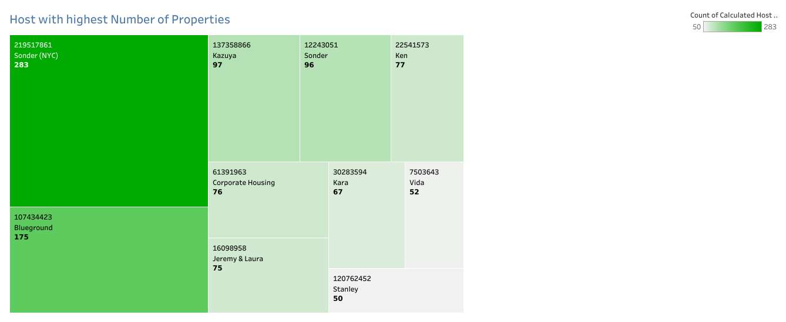
Highest Number of Properties per Host
Sonder(NYC) has the highest number of properties hosted with 283 followed by Blueground with 175 properties hosted.

Slide 10
Recommendations
We can look into Brooklyn for expansion as it cheaper than expanding in Manhattan and is even close to commercial proximity.
Look into Entire house/apartment's which is most proffered by business travelers.

Slide 11
APPENDIX - DATA SOURCES:
An Idea into the Data Dictionary :
- Area demographics such as borough, neighbourhood, latitude and longitude.
- Hosts information such as id,hostname, availability, minimum nights,price,room type.
Data Sources Used:
- Airbnb data

Slide 12
APPENDIX - DATA METHODOLOGY
Our data cleanup and process were as follows:
We cleanup up the borough section completely as it was important for our analysis.
Putting up all the data on the map to come up with the most popular area.
Using heatmaps and bar chart to show the difference in prices and most owned properties.

